Slide 1
BOM model
window
screen
location
navigator
history
event
document
The window is the global object in JavaScript object hierarchy

Slide 2
screen object
The screen object provides information about the desktop outside the browser .
This object allows scripts to:
Detect the browser’s usable area.
Return information on the display screen's dimensions and color depth
MDN

Slide 3
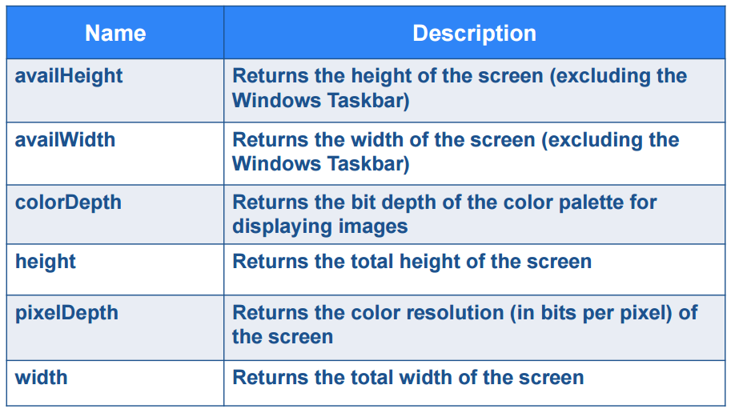
Screen object - properties
w3schools
Returns the number of bits used to represent the color of a single pixel

Slide 4
Navigator object
The navigator object represents the browser application.
This object allows scripts to see:
browser type
browser version
All of its properties are read-only
MDN

Slide 5
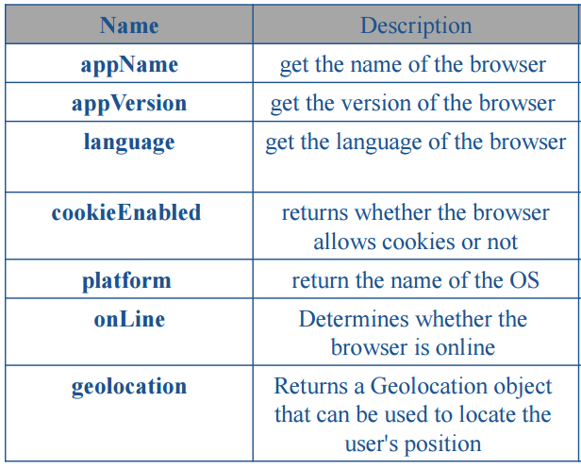
Navigator object - properties
w3schools

Slide 6
Location object
The Location object is part of a Window object.
The location Object refers to the current URL
MDN

Slide 7
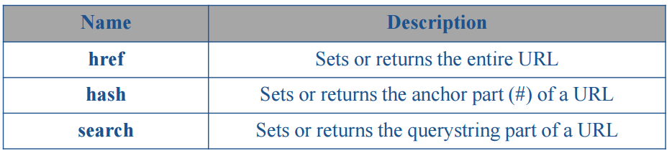
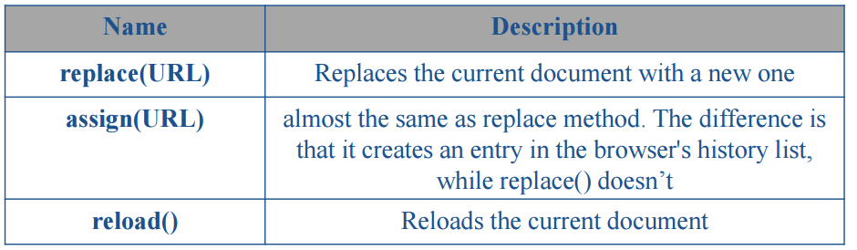
Location object - properties and methods
w3schools

Slide 8
History object
The history Object is an Array of URLs.
The history Object lets you send the user to somewhere in the history list from within a JavaScript program
MDN

Slide 9
History object - properties and methods
w3schools
Name | Description
length | Returns the number of URLs (pages) in the history list
back() | Loads the previous URL (page) in the history list
forward() | Loads the next URL (page) in the history list
go(step) | Loads a specific URL (page) from the history list

Slide 10
BOM model
window
screen
location
navigator
history
event
document
The document object represents the entire HTML

Slide 11
DOM
The document object represents the entire HTML
document and can be used to access all elements in a page.
A page is what appears within the browser window.
So, every window is associated with a document object.
Document Object has its own set of Properties, Collections, Methods & Event handlers.
MDN

Slide 12
Dealing with DOM
According to the DOM, everything in an HTML document is a node.
• The DOM says:
– The entire document is a document node
– Every HTML element is an element node
– The text in the HTML elements are text nodes
– Every HTML attribute is an attribute node
– Comments are comment nodes

Slide 13
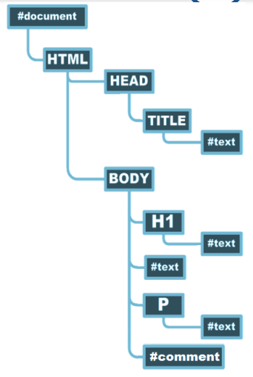
Node tree
<html>
<head>
<title>Simple Example!</title>
</head>
<body>
<h1>Greeting</h1>
Welcome All
<p>A paragraph</p>
<!—and that’s all-->
</body>
</html>

Slide 14
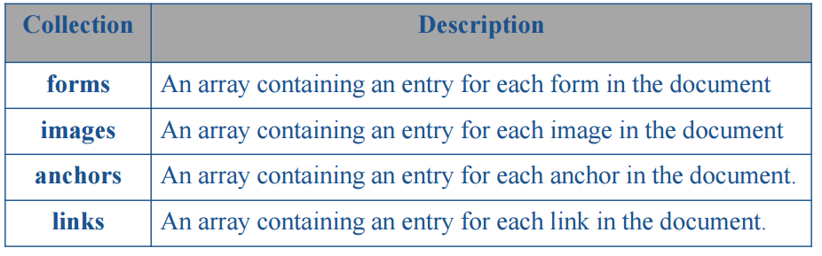
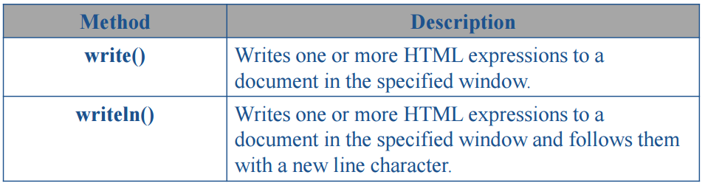
DOM - collections and methods
w3schools

Slide 15
Node List
Node Lists have One Property
– length : gives the length of the Collection.
• e.g. childNodes.length: returns number of elements inside the collection
• We can check if there is child collection using
– hasChildNodes(): Tells if a node has any children
• We can check if there is attribute collection using
– hasAttributes(): Tells if a node has any attributes
– childNodes[ ] : Collection of element’s children
– attributes[ ] : Returns an array of the attributes of an
element

Slide 16
Dealing with DOM
Dealing with nodes fall into six main categories:
– Accessing Node
– Modifying Node’s content
– Change Node’s style
– Adding New Node
– Remove Node from tree
– Adding event to Node

Slide 17
Accessing DOM Nodes
You can access a node in 5 ways:
– document.getElementById(“id”)
– document.getElementsByName(“name”)
– document.getElementsByTagName(“tagname”)
– document.getElementsByClassName(“Classname”)
– New HTML5 Selectors.
– By navigating the node tree, using the node relationships

Slide 18
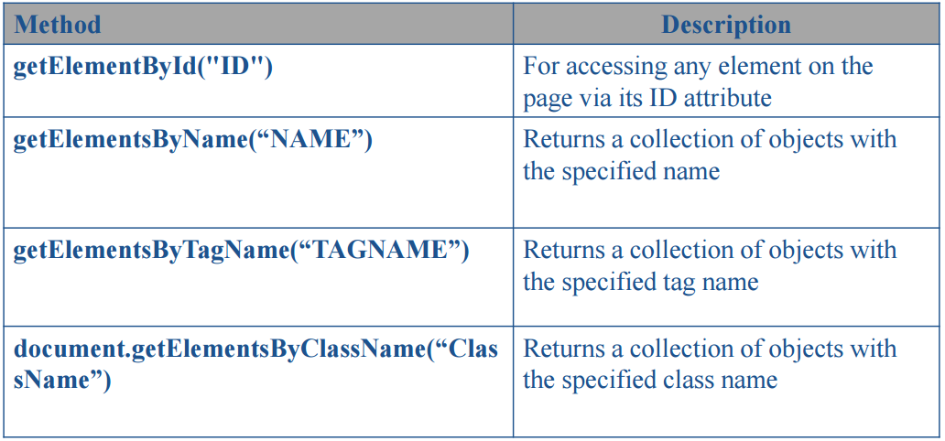
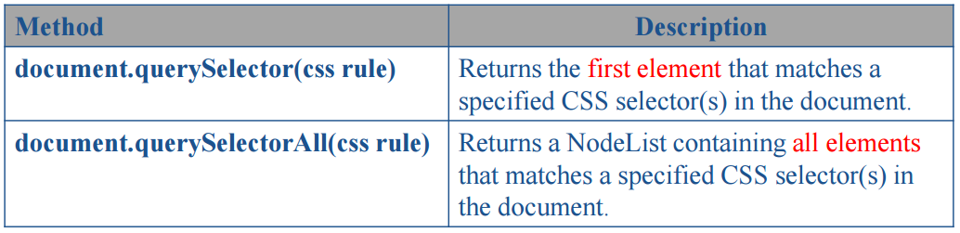
Accessing DOM Nodes

Slide 19
Nodes Relationships
– The terms parent, child, and sibling are used to describe the relationships.
– Parent nodes have children.
– Children on the same level are called siblings (brothers or
sisters).
• In a node tree, the top node is called the root
• Every node, except the root, has exactly one parent
node
• A node can have any number of children
• A leaf is a node with nchildren
• Siblings are nodes with the same parent

Slide 20
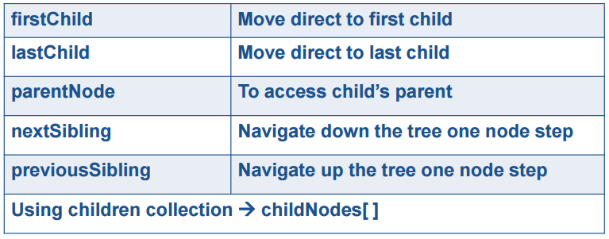
Nodes Relationships
Navigating the node tree, using the node relationships:

Slide 21
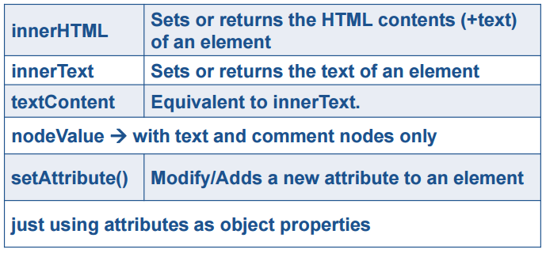
Modifying Node’s Content and style
Changing the Text Node by using
Modifying Styles:
– Node.style

Slide 22
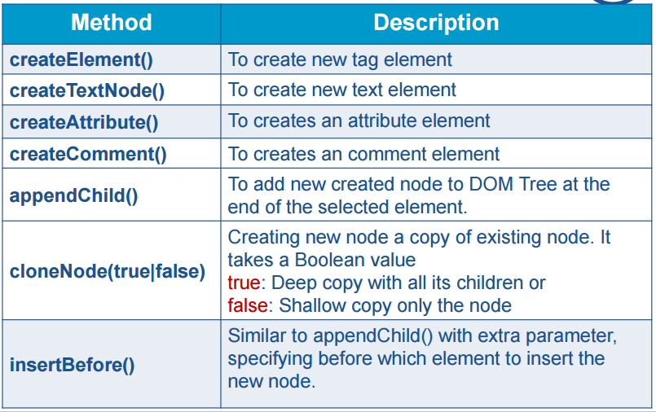
Creating & Adding Nodes

Slide 23
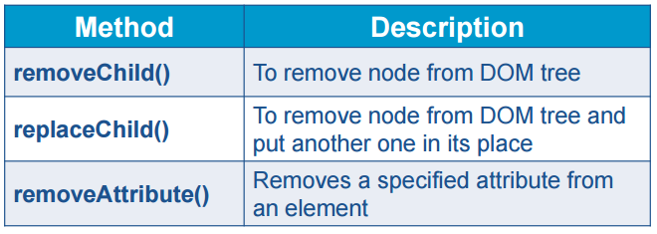
Removing DOM Nodes

Slide 24
ADDITIONAL RESOURCES
HTMLCollection vs NodeList : https://dev.to/jharteaga/difference-between-htmlcollection-and-nodelist-25bp

